Slide 1
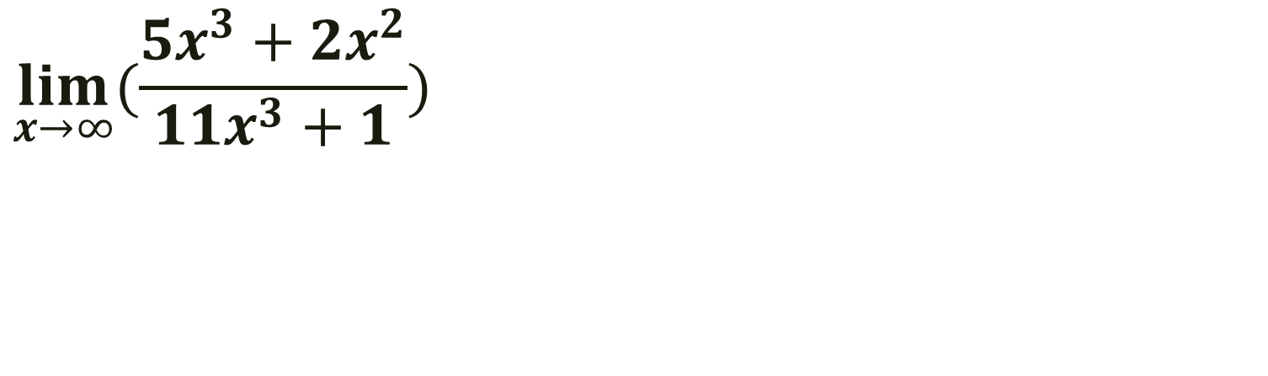
Bell Work
$$\lim_{x→∞}{(\frac{{5x}^{3}+{2x}^{2}}{{11x}^{3}+1})}$$

Slide 2
Pre-calc trig
Day 75

Slide 3
From Last Time
Page 887 # 9, 13, 17, 23
Do we need to talk more about the notes?

Slide 4
12.5 The Area Problem
Objective: To find limits of summations

Slide 5
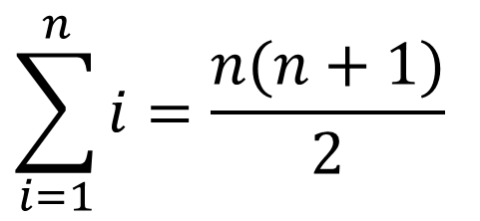
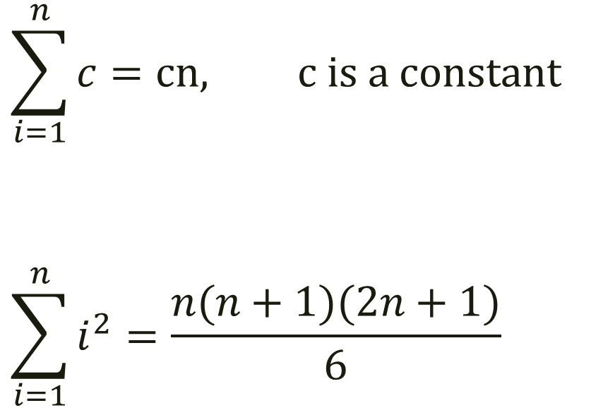
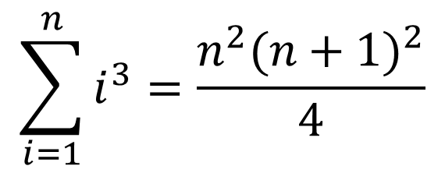
Limits of Summations
$$\sum_{i=1}^{n}{c}=cn, c is a constant$$
$$\sum_{i=1}^{n}{i^{2}}=\frac{n(n+1)(2n+1)}{6}$$
$$\sum_{i=1}^{n}{i}=\frac{n(n+1)}{2}$$
$$\sum_{i=1}^{n}{i^{3}}=\frac{n^{2}{(n+1)}^{2}}{4}$$

Slide 6
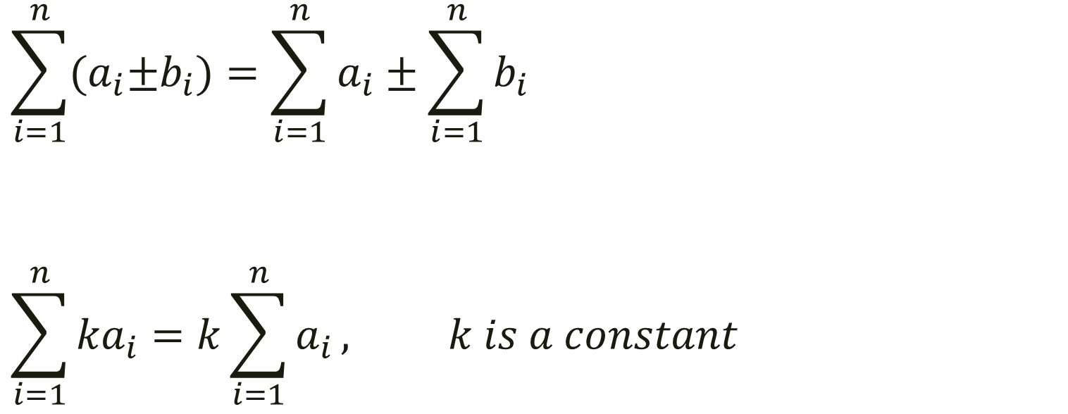
Limits of Summations
$$\sum_{i=1}^{n}{{(a}_{i}±b_{i})}=\sum_{i=1}^{n}{a_{i}±\sum_{i=1}^{n}{b_{i}}}$$
$$\sum_{i=1}^{n}{{ka}_{i}}=k\sum_{i=1}^{n}{a_{i}}, k is a constant$$

Slide 7
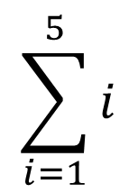
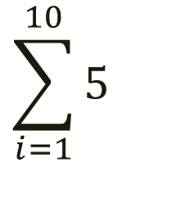
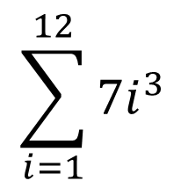
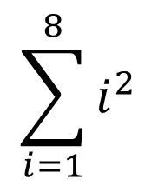
Examples
$$\sum_{i=1}^{10}{5}$$
$$\sum_{i=1}^{5}{i}$$
$$\sum_{i=1}^{8}{i^{2}}$$
$$\sum_{i=1}^{12}{{7i}^{3}}$$

Slide 8
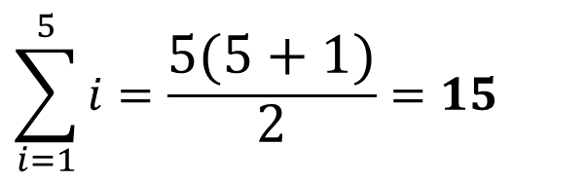
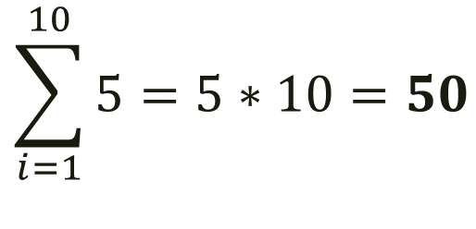

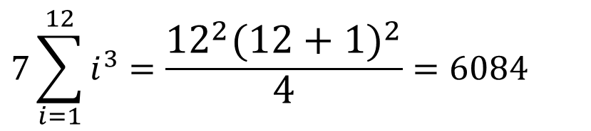
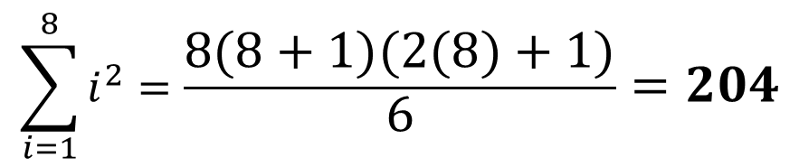
Examples (solutions)
$$\sum_{i=1}^{10}{5=5∗10=50}$$
$$\sum_{i=1}^{5}{i=\frac{5(5+1)}{2}}=15$$
$$\sum_{i=1}^{8}{i^{2}=\frac{8(8+1)(2(8)+1)}{6}=204}$$
$$7\sum_{i=1}^{12}{i^{3}=\frac{{12}^{2}{(12+1)}^{2}}{4}}=6084$$
$$7(6084)=42588$$

Slide 9
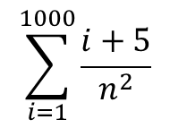

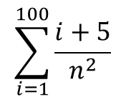
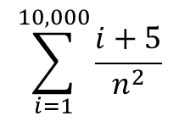
Example. Simplify. Then evaluate the following.
$$\sum_{i=1}^{n}{\frac{i+5}{n^{2}}}$$
$$\sum_{i=1}^{100}{\frac{i+5}{n^{2}}}$$
$$\sum_{i=1}^{1000}{\frac{i+5}{n^{2}}}$$
$$\sum_{i=1}^{10,000}{\frac{i+5}{n^{2}}}$$

Slide 10
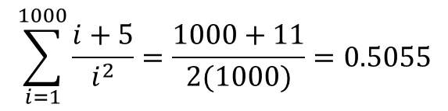
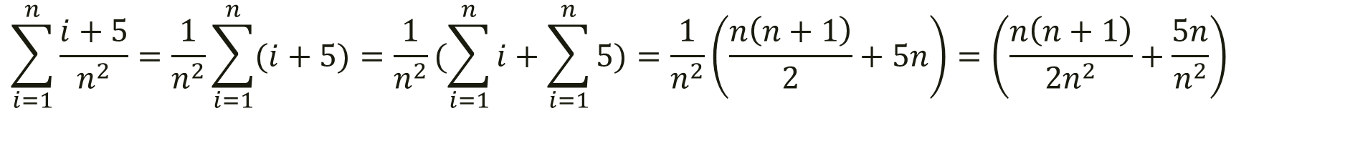
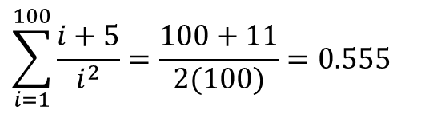
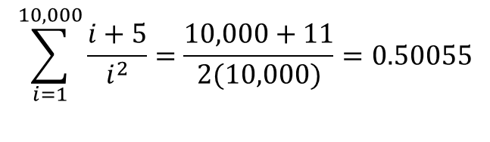
Example. Simplify. Then evaluate the following.
$$\sum_{i=1}^{n}{\frac{i+5}{n^{2}}}=\frac{1}{n^{2}}\sum_{i=1}^{n}{(i+5)}=\frac{1}{n^{2}}(\sum_{i=1}^{n}{i+\sum_{i=1}^{n}{5})}=\frac{1}{n^{2}}\left(\frac{n\left(n+1\right)}{2}+5n\right)=\left(\frac{n\left(n+1\right)}{2n^{2}}+\frac{5n}{n^{2}}\right)$$
$$\left(\frac{n+1}{2n}+\frac{5}{n}\right)=\left(\frac{n+1}{2n}+\frac{10}{2n}\right)=\left(\frac{n+11}{2n}\right)$$
$$\sum_{i=1}^{100}{\frac{i+5}{i^{2}}}=\frac{100+11}{2(100)}=0.555$$
$$\sum_{i=1}^{1000}{\frac{i+5}{i^{2}}}=\frac{1000+11}{2(1000)}=0.5055$$
$$\sum_{i=1}^{10,000}{\frac{i+5}{i^{2}}}=\frac{10,000+11}{2(10,000)}=0.50055$$

Slide 11
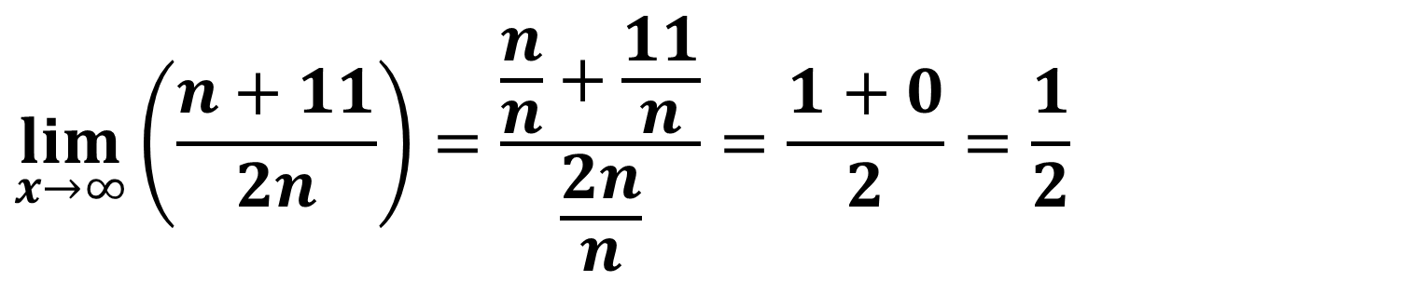
Extra: Could we apply this to a limit as it approaches infinity?
$$\lim_{x→∞}\left(\frac{n+11}{2n}\right)=\frac{\frac{n}{n}+\frac{11}{n}}{\frac{2n}{n}}=\frac{1+0}{2}=\frac{1}{2}$$
Does this hold up with what we were noticing as our n value got larger?

Slide 12
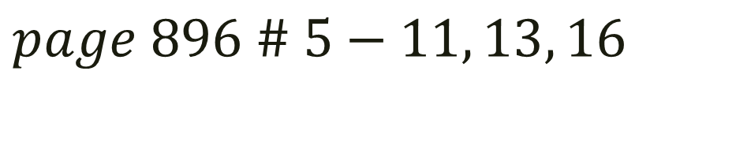
For Next Time...
$$page 896 \# 5−11, 13, 16$$

